Slide 1
ORGANIZATIONAL MTG.
THE BIG 4

Slide 2

#1 EARLY IS EASY

Slide 3
185s and 365s – July
SE Compliance – August
All other forms by the due date

Slide 4
#2 CULTURE OF INVITATION

Slide 5
Changing vocabulary – Invite not Recruit
When we invite we evangelize
Where and when can we Invite anytime - anywhere

Slide 6
#3 OPPORTUNITIES

Slide 7
COR
Our Programs
Pending Applications List
Prospect Tab
Market Penetration
Men’s Conferences
Parish Events

Slide 8
#4 PARTNERSHIPS

Slide 9
4th Degree Districts Diocese/Archdiocese
Outside Organizations
Our Insurance Agencies

Slide 10
Award Updates

Slide 11
Star District 2026 – 2027
Membership Growth (No Change)
  Attain 70% of combined council quotas
Insurance Promotion (No Change)
  At least 50% of assigned councils earn the Founders Award

Slide 12
Star District 2026 – 2027
Overall District Excellence
  At least two councils in the district earn the Star Council Award
    Districts with one council are not eligible
  Submit a District Deputy Annual Report on Council Status (#944) for each council in district by September 15
  Every council in district must submit forms #185 (officers), #365 (directors), 1728 (annual survey) and #1295 (annual audit)

Slide 13
Star Council 2026 – 2027
Earn the McGivney, Founders’, and Columbian Awards, and satisfy all administrative requirements
2026-2027 Administrative Requirements
Be in good standing with Supreme Council (pay assessments)
Safe Environment compliant (U.S. & Canada only)
Submit forms #185 (Report of Officers), #365 (Report of Directors), #1728 (Annual Survey)
NEW: Submit form #1295 (Annual Audit)

Slide 14
McGivney Award 2026 – 2027
NO CHANGES
Attain 6% intake growth based on July 1st council membership
Minimum 5 / Maximum 15

Slide 15
Founders’ Award 2026 – 2027
A number equal to 10% of Associate members on the July 1 council roster must meet individually with a field agent for a financial review
Minimum 5 / Maximum 15
To qualify, meetings must be with new or associate members

Slide 16
Old Columbian Award
Time-consuming
Confusing
Subjective
Quantity, not quality

Slide 17
New Columbian Award
Fast
Simple
Quality, not quantity

Slide 18
Requirement 1
Donate $500 toward any of the following:
    ASAP (cash or item value)
    Food for Families (cash or 1,000 lbs.)
    Coats for Kids
    RSVP

Slide 19
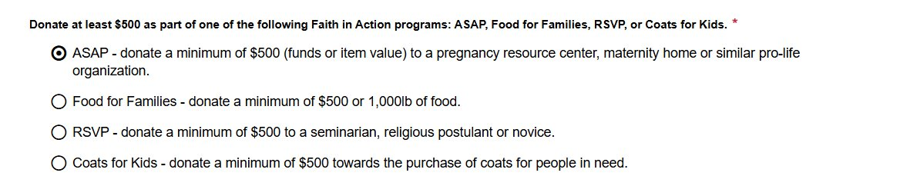

Slide 20
Requirement 2
Complete 4 programs
    1 per category (Faith, Family, Community, Life)

Slide 21
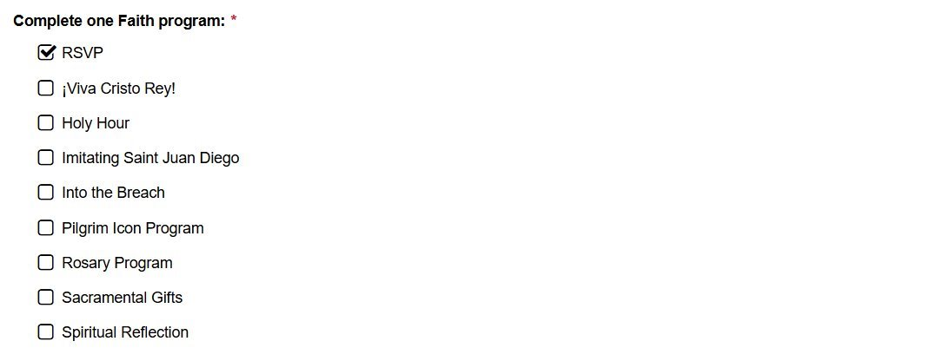

Slide 22
Requirement 3
Conduct Cor monthly
    Include name and email of EFF Director
OR
  3 unique programs/activities
    Build fraternity
    Bring men closer to Christ
    Serve parish or community

Slide 23
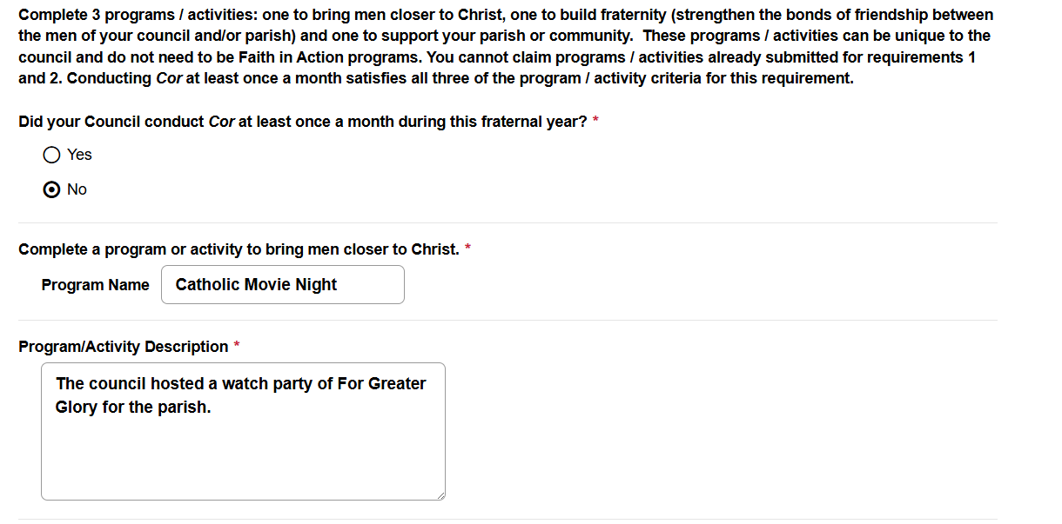

Slide 24
Columbian Award Outcomes
Improved processing
    Fewer applications denied
    Faster approvals
Mission alignment
    More council donations
    More Cor participants
    More fraternal events
Happier councils, more members

Slide 25
2026-2027 Fraternal Mailing
Fraternal Planner
Fraternal Excellence Guide
Protocol, Meetings, and Ceremonials Book
Faith in Action Guidebook
Officers Online Access Infographic
Suggested Training By Office Infographic
Fishers of Men Guidebook
Cor Leader Guide
Cor Formation Content Guide
Working with Men’s Ministries

