Slide 2
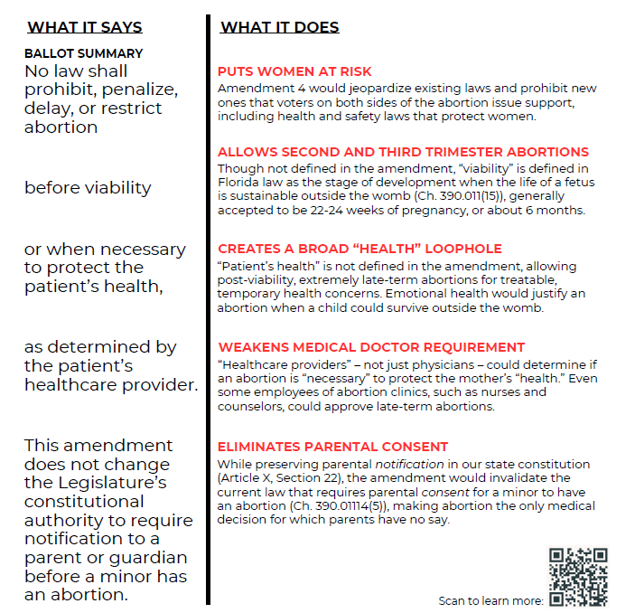

Slide 3
What can you do:
Offer to assist your pastor in spreading the word about Amendment 4. There are resources available to every parish, including bulletin inserts and a pulpit announcement.
Contribute to the political committee established to oppose Amendment 4: Florida Voters Against Extremism, also known as Vote No on 4 Florida.
And of course, vote against Amendment 4. Share the reasons with friends and family and your council.

Slide 4
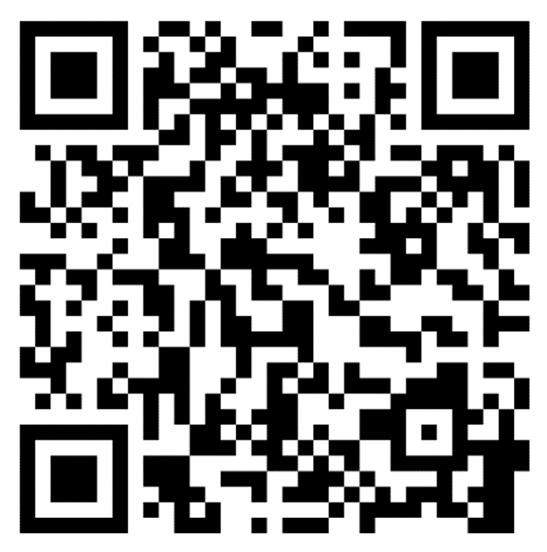
www.flaccb.org/abortion-amendment

Slide 5
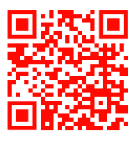
www.tooextremeforfl.com

