Slide 2
Sacred Heart Holy Hour
Leader:
Welcome to this Sacred Heart Holy Hour. During this hour, we will hear readings from Sacred Scripture and reflections from Pope Francis on the Sacred Heart of Jesus. We will pray the Divine Mercy Chaplet, prayers to the Sacred Heart and have the opportunity for silent prayer. The Knights of Columbus are proud to coordinate this holy hour and hope that it will lead all present to grow in our love for God and devotion to His Most Sacred Heart.

Slide 3
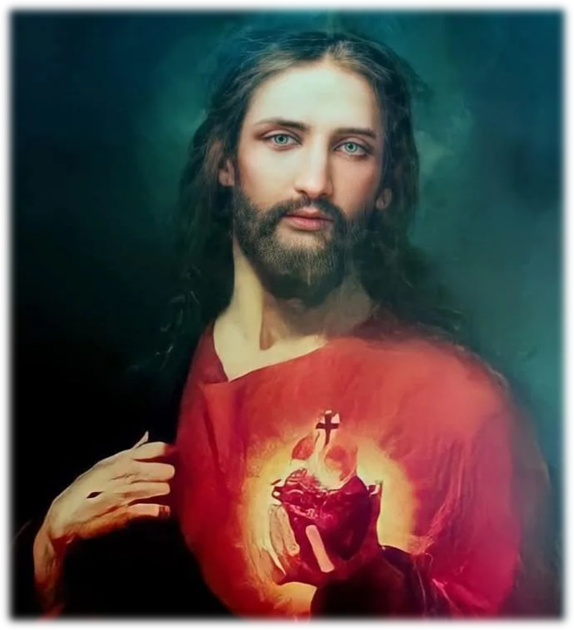
Love Divine,
All Loves Excelling

Slide 4
Love divine, all loves excelling,
Joy of heav’n, to earth come down!
Fix in us your humble dwelling;
All your faithful mercies crown.
Jesus, source of all compassion,
Love unbounded, love all pure;
Visit us with your salvation,
Let your love in us endure.

Slide 5
Come, almighty to deliver,
Let us all your life receive;
Suddenly return and never,
Never more your temples leave.
Lord, we would be always blessing,
Serve you as your hosts above,
Pray, and praise you without ceasing,
Glory in your precious love.

Slide 6
Finish then your new creation,
Pure and spotless, gracious Lord;
Let us see your great salvation
Perfectly in you restored.
Changed from glory into glory,
Till in heav'n we take our place,
Till we sing before the almighty,
Lost in wonder, love and praise.

Slide 7
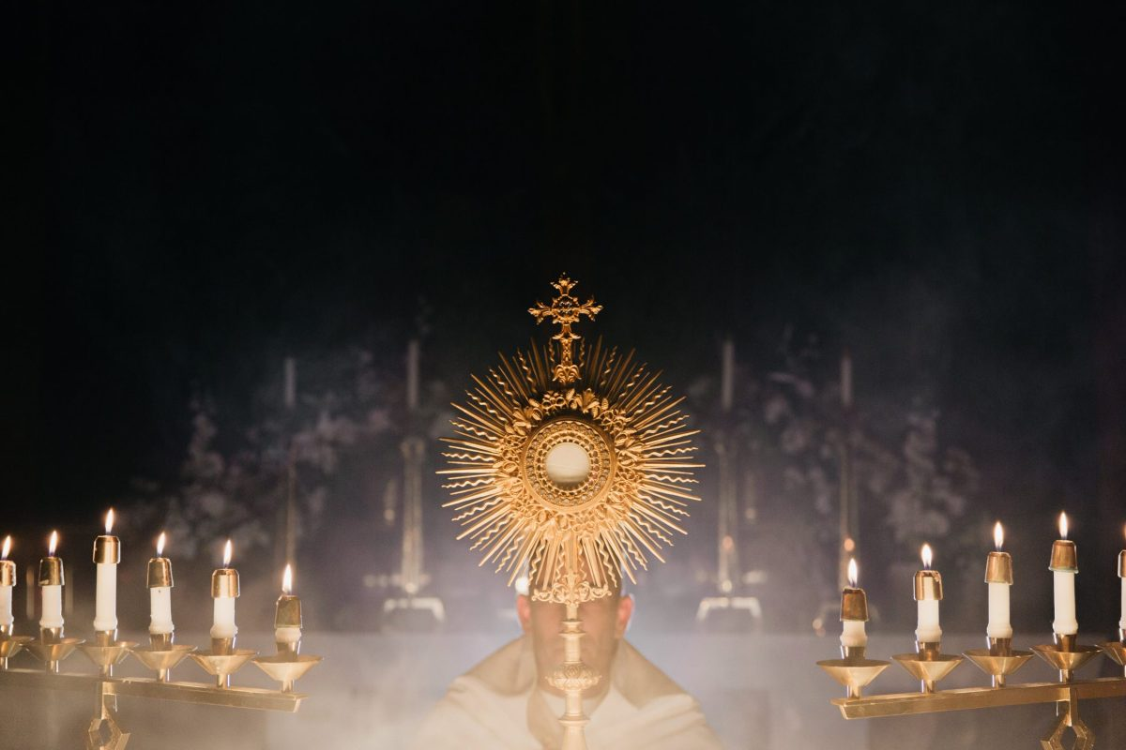
Exposition
Please kneel.
"O Salutaris Hostia"

Slide 8
0 salutáris Hóstia, quae caeli pandis óstium, bella premunt hostília: da robur, fer auxílium.
0 saving Victim, opening wide
The gate of Heaven to man below;
Our foes press hard on every side;
Thine aid supply; thy strength bestow.

Slide 9
Uni trinóque Dómino sit sempitérna gloria, qui vitam sine término nobis donet in pátria. Amen
To thy great name be endless praise,
Immortal Godhead, One in Three. Oh, grant us endless length of days, In our true native land with thee. Amen.

Slide 10

Sacred Silence

Slide 11
Liturgy of the Word
Opening Prayer
Leader: Let us pray.
Clothe us, Lord God, with the virtues of the Heart of your Son and set us aflame with his love, that, conformed to his image, we may merit a share in eternal redemption.
Through our Lord Jesus Christ, your Son, who lives and reigns with you in the unity of the Holy Spirit, God, for ever and ever.
AMEN

Slide 12
First Reading
Hosea 11:1, 3-4, 8 c9
Thus says the LORD:
When Israel was a child I loved him,
out of Egypt I called my son.
Yet it was I who taught Ephraim to walk, who took them in my arms;
I drew them with human cords,
with bands of love;
I fostered them like one
who raises an infant to his cheeks;
Yet, though I stooped to feed my child,
they did not know that I was their healer.

Slide 13
First Reading
Hosea 11:1, 3-4, 8 c9
My heart is overwhelmed,
my pity is stirred.
I will not give vent to my blazing anger,
I will not destroy Ephraim again;
For I am God and not a man,
the Holy One present among you;
I will not let the flames consume you.
The word of the Lord.
R:Thanks be to God.

Slide 15
Responsorial Psalm
Isaiah 12:2-3, 4, 5-6
R:You will draw water joyfully from the springs of salvation.
God indeed is my savior;
I am confident and unafraid.
My strength and my courage is the LORD, and he has been my savior.
With joy you will draw water at the fountain of salvation.
R:You will draw water joyfully from the springs of salvation.
Give thanks to the LORD, acclaim his name; among the nations make known his deeds, proclaim how exalted is his name.

Slide 16
Responsorial Psalm
Isaiah 12:2-3, 4, 5-6
R:You will draw water joyfully from the springs of salvation.
Sing praise to the LORD for his glorious achievement;
let this be known throughout all the earth.
Shout with exultation, 0 city of Zion,
for great in your midst
is the Holy One of Israel!
R:You will draw water joyfully from the springs of salvation.

Slide 18
Second Reading
Ephesians 3:8-12, 14-19
Brothers and sisters:
To me, the very least of all the holy ones, this grace, was given, to preach to the Gentiles the inscrutable riches of Christ,
and to bring to light for all what is the plan of the mystery hidden from ages past in God who
created all things, so that the manifold wisdom of God
might now be made known through the church
to the principalities and authorities in the heavens.

Slide 19
Second Reading
Ephesians 3:8-12, 14-19
This was according to the eternal purpose that he accomplished in Christ Jesus our Lord, in whom we have boldness of speech
and confidence of access through faith in him.
For this reason I kneel before the Father,
from whom every family in heaven and on earth is named, that he may grant you in accord with the
riches of his glory
to be strengthened with power through his Spirit in the inner self, and that Christ may dwell in
your hearts through faith;

Slide 20
Second Reading
Ephesians 3:8-12, 14-19
that you, rooted and grounded in love,
may have strength to comprehend with all the holy ones what is the breadth and length and height and depth,
and to know the love of Christ which surpasses knowledge, so that you may be filled with all
the fullness of God.
The word of the Lord.
R Thanks be to God.

Slide 22
Gospel
John 19:3137
Since it was preparation day,
in order that the bodies might not remain on the cross on the sabbath, for the sabbath day of that week was a solemn one, the Jews asked Pilate that their legs be broken and they be taken down.
So the soldiers came and broke the legs of the first and then of the other one who was crucified with Jesus.

Slide 23
Gospel
John 19:3137
But when they came to Jesus and saw that he was already dead, they did not break his legs, but one soldier thrust his lance into his side, and immediately blood and water flowed out.
An eyewitness has testified, and his testimony is true; he knows that he is speaking the truth,
so that you also may come to believe.

Slide 24
Gospel
John 19:3137
For this happened so that the Scripture passage might be fulfilled:
Not a bone ofit will be broken.
And again another passage says:
They will look upon him whom they have pierced.
The Gospel of the Lord.
Praise to you, Lord Jesus Christ.

Slide 25
reflections

Slide 26
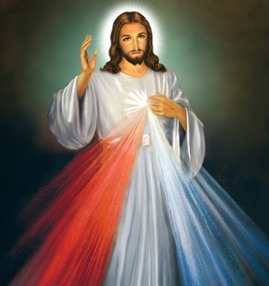
Divine mercy chaplet
(Repeat three times)
O Blood and Water, which gushed forth from the Heart of Jesus as a fount of mercy for us,
I trust in You!
Our Father, Hail Mary, Apostle’s Creed

Slide 27
Divine mercy chaplet
Our Father, who art in heaven, hallowed be thy name, thy kingdom come, thy will be done on earth as it is in heaven.
Give us this day, our daily bread, and forgive us our trespasses, as we forgive those who trespass against us, and lead us not into temptation, but deliver us from evil.

Slide 28
Divine mercy chaplet
Hail Mary, full of grace, the Lord is with you. Blessed art thou among women and blessed is the fruit of your womb, Jesus.
Holy Mary, Mother of God, pray for us sinners now and at the hour of our death.
Amen

Slide 29
Divine mercy chaplet
I believe in God,
the Father almighty,
Creator of heaven and earth,
and in Jesus Christ, his only Son,
our Lord, who was conceived by the Holy Spirit, born of the Virgin Mary,
suffered under Pontius Pilate,
was crucified, died and was buried; he descended into hell;
on the third day he rose again from the dead; he ascended into heaven,
and is seated at the right hand of God the Father almighty;
from there he will come to judge the living and the dead.

Slide 30
Divine mercy chaplet
I believe in the Holy Spirit,
the holy catholic Church,
the communion of saints,
the forgiveness of sins,
the resurrection of the body,
and life everlasting.
Amen.

Slide 31

Eternal Father, I offer you the
Body and Blood, Soul and
Divinity of Your Dearly
Beloved Son, Our Lord,
Jesus Christ, in atonement for
our sins and those of the whole world.
(On the 10 Small Beads of Each Decade)
For the sake of His sorrowful Passion, have mercy on us and on the whole world.

Slide 32
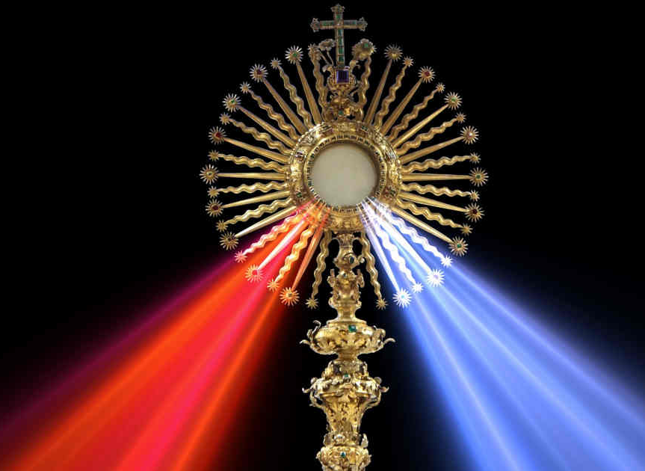
(Repeat three times)
Holy God,
Holy Mighty One,
Holy Immortal One,
have mercy on us
and on the
whole world.

Slide 33
Eternal God, in whom mercy is endless and the treasury of compassion — inexhaustible, look kindly upon us and increase Your mercy in us, that in difficult moments we might not despair nor become despondent, but with great confidence submit ourselves to Your holy will, which is Love and Mercy itself.

Slide 34
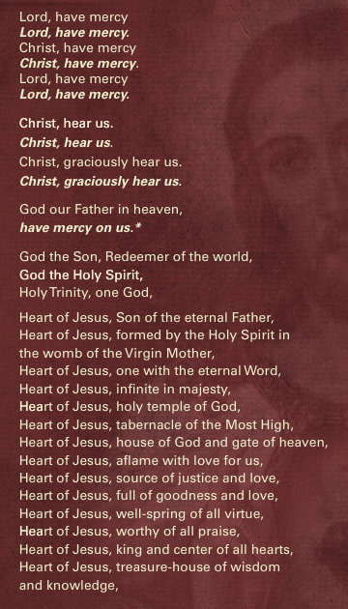

Slide 35
The response is: have mercy on us.

Slide 36
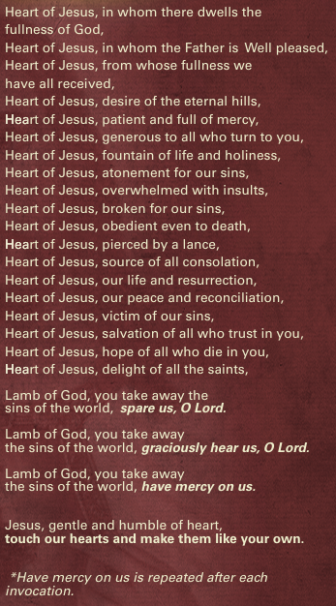
The response is: have mercy on us.

Slide 38

Most loving Jesus,
how great is the love which you have poured out upon the world.
How casual and careless is our response!
Kneeling before you, we wish to atone for the indifference and the slights which pierce you to the heart.
Praise to the heart of Jesus, our Savior and our God.

Slide 39
We ask forgiveness for our own shameful neglect.
We wish to make amends for those who are obstinate in their unbelief, for those who turn away from the light and wander like sheep without a shepherd;
and for those who have broken their baptismal promises
and reject the gentle yoke of your law. Praise to the heart of Jesus, our Savior and our God.

Slide 40
We wish to make amends for the sins of our society:
for lust and degradation,
for corruption of the young,
for indifference and blasphemy,
for attacks against your Church,
for irreverence and even sacrilege against your love in this blessed sacrament,
and for the public defiance of your law.
Praise to the heart of Jesus, our Savior and our God.

Slide 41
These are the sins for which you died, but now we share in your atonement by offering on the altar in union with you
the living sacrifice you made on the cross,
joining to it the sufferings of your Virgin Mother,
and those of all the saints and the whole Church.
Praise to the heart of Jesus, our Savior and our God.

Slide 42
We promise faithfully
that by your grace
we shall make reparation for our own sins
and for those of others
by a strong faith,
by holy living,
and by obedience to the law of the Gospel,
whose greatest commandment is that of charity.
Praise to the heart of Jesus, our Savior and our God.

Slide 43
We also promise to do our best
to discourage others from insulting you
and bring those we can to follow you. Praise to the heart of Jesus, our Savior and our God.

Slide 44
Jesus, Lord,
receive this loving act of homage together with the prayers of our Lady, who stood by the cross,
our model in reparation.
Keep us faithful, even to the point of death,
give us the gift of perseverance
and lead us all to our promised land in heaven,
where you, with the Father and the Holy Spirit,
live and reign for ever and ever. Amen. Praise to the heart of Jesus, our Savior and our God.

Slide 45
Act of Consecration to the Sacred Heart
St. Margaret Mary Alacoque
I give and consecrate to the Sacred Heart of our Lord Jesus Christ my person and my life, my actions, penances, and sufferings, not wishing to make use of any part of my being for the future except in honoring, loving, and glorifying that Sacred Heart. It is my irrevocable will to be entirely his, and to do everything for his love, renouncing with my whole heart whatever might displease him.

Slide 46
Act of Consecration to the Sacred Heart
St. Margaret Mary Alacoque
I take you then, O most Sacred Heart, as the sole object of my love, as the protector of my life, as the pledge of my salvation, as the remedy of my frailty and inconstancy, as the repairer of all the defects of my life, and as my secure refuge in the hour of death. Be then, O Heart of goodness, my justification before God the Father, and remove far from me the thunderbolts of his just wrath.

Slide 47
Act of Consecration to the Sacred Heart
St. Margaret Mary Alacoque
O Heart of love, I place my whole confidence in you. While I fear all things from my malice and frailty, I hope all things from your goodness. Consume then in me whatever can displease or be opposed to you, and may your pure love be so deeply impressed upon my heart that it may be impossible that I should ever be separated from you or forget you.

Slide 48
Act of Consecration to the Sacred Heart
St. Margaret Mary Alacoque
I implore you, by all your goodness, that my name may be written in you, for in you I wish to place all my happiness and all my glory, living and dying in very bondage to you.
Amen.

Slide 49
benediction

Slide 50
Tantum ergo Sacraméntum
Venerémur cérnui:
Et antiquum documéntum
Novo cedat ritui:
Praestet fides suppleméntum
Sénsuum deféctui.

Slide 51
Genitóri, Genitóque
Laus et jubilátio,
Salus, honor, virtus quoque
Sit et benedictio:
Procedénti ab utróque
Compar sit laudátio.
Amen.

Slide 52
Presider: Let us pray.
  O God, who in this wonderful Sacrament have left us a memorial of your Passion, grant us, we pray, so to revere the sacred mysteries of your Body and Blood that we may always experience in ourselves the fruits of your redemption. Who live and reign for ever and ever.
All: Amen.

Slide 53
The Divine Praises
All:
Blessed be God.
Blessed be his holy Name.
Blessed be Jesus Christ, true God and true man.
Blessed be the Name of Jesus.
Blessed be his most Sacred Heart. Blessed be his most Precious Blood.
Blessed be Jesus in the most holy Sacrament of the altar.
Blessed be the Holy Spirit, the Paraclete.

Slide 54
The Divine Praises
All:
Blessed be the great Mother of God, Mary most holy.
Blessed be her holy and Immaculate Conception.
Blessed be her glorious Assumption.
Blessed be the name of Mary, Virgin and Mother.
Blessed be Saint Joseph, her most chaste Spouse.
Blessed be God in his Angels and in his Saints.

Slide 55
Concluding Prayer
Leader:
  O Most Sacred Heart of Jesus, pour down your blessings abundantly upon your Church, upon the Supreme Pontiff, and upon all the clergy; give perseverance to the just, convert sinners, enlighten unbelievers, bless our parents, friends, and benefactors, help the dying, free the souls in purgatory, and extend over all hearts the sweet empire of your love. Amen.
All: Amen.

Slide 56
Holy God, We Praise Thy Name

Slide 57
Holy God, we praise thy name;
Lord of all, we bow before thee!
All on earth thy scepter claim,
All in heav’n above adore thee;
Infinite, thy vast domain,
Everlasting is thy reign.
Infinite, thy vast domain,
Everlasting is thy reign.

Slide 58
Hark! the loud celestial hymn
Angel choirs above are raising;
Cherubim and Seraphim,
In unceasing chorus praising;
Fill the heav’ns with sweet accord: “Holy, holy, holy Lord!”
Fill the heav’ns with sweet accord:“Holy, holy, holy Lord!”

Slide 59
Holy Father, Holy Son,
Holy Spirit, Three we name thee;
While in essence only One,
Undivided God we claim thee;
And adoring, bend the knee,
While we own the mystery.
And adoring, bend the knee,
While we own the mystery.

