Slide 1
Deer Hunting Retreat
Rifle Hunt
Madisonville, KY
Nov. 8-12, 2024
IronmanOutdoors.org
Notes:
1

Slide 2
Hunt Deer in Western KY
Who: Men only – age 18 and older
Where: Madisonville, KY
Dates: Nov. 8-12, 2024
Cost: $1200 per man
All Meals Included
6 Hunts on Private Land
Manhood Discussions
No Trophy Fees
KY NR license = $330

Slide 3
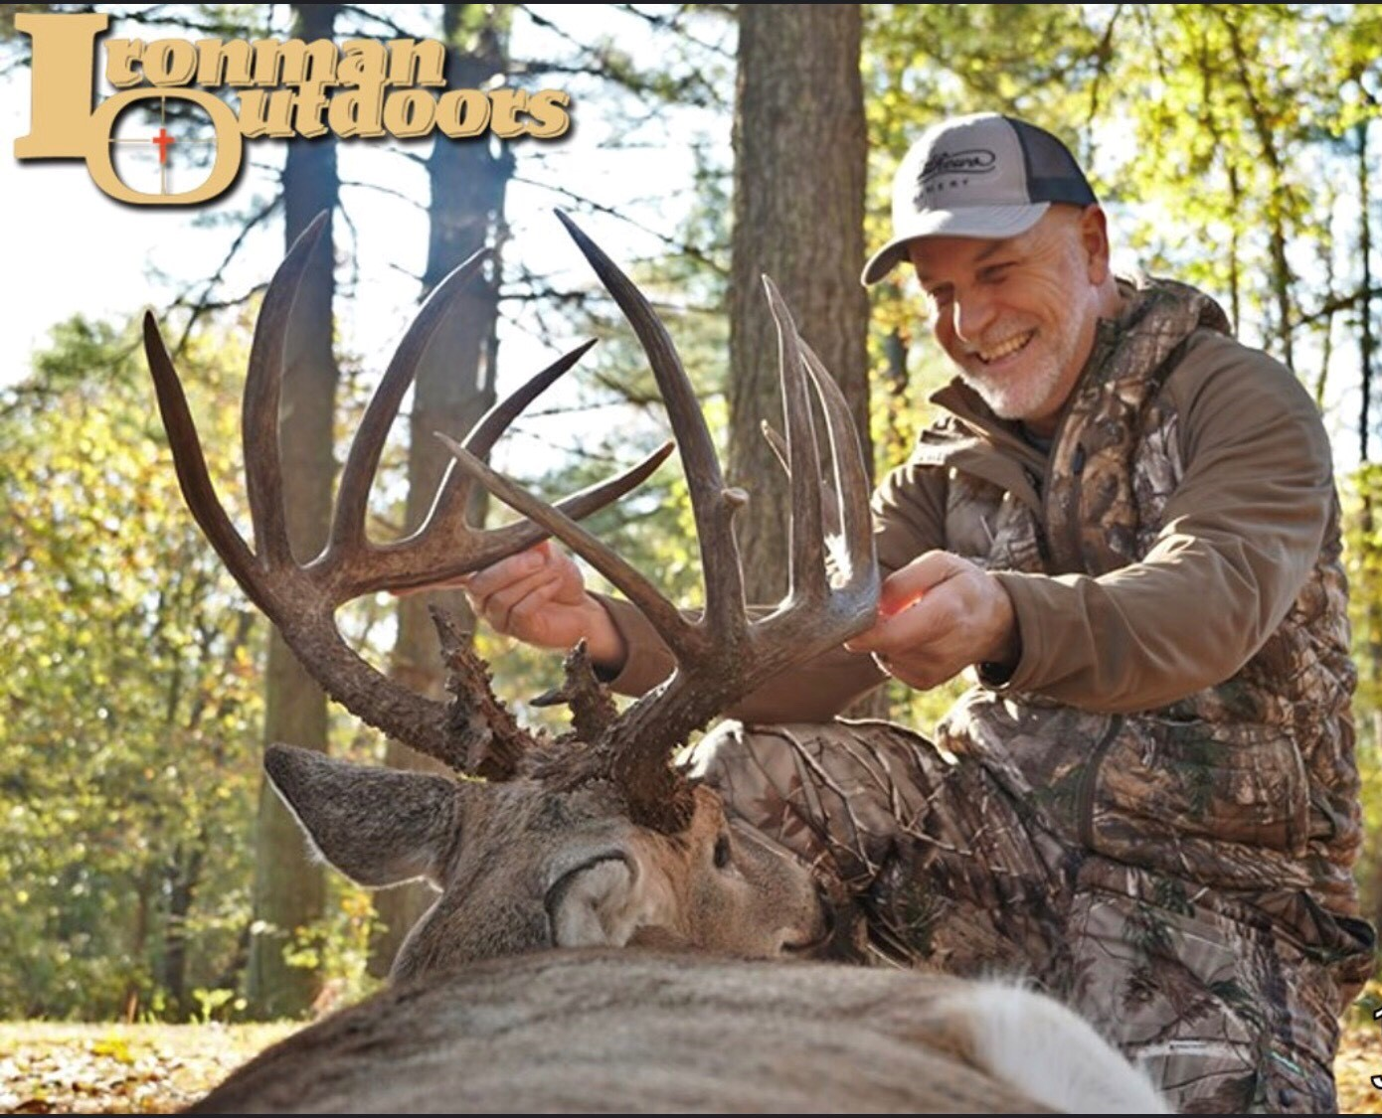
Welcome to Ironman Outdoors
Western Kentucky is known for producing trophy bucks. In fact, in 2011, Kentucky led the country with 34 bucks entered into the Boone and Crockett Club. This buck was taken on an IO retreat in KY in the fall of 2019 and scored over 195 inches.
IronmanOutdoors.org

Slide 4
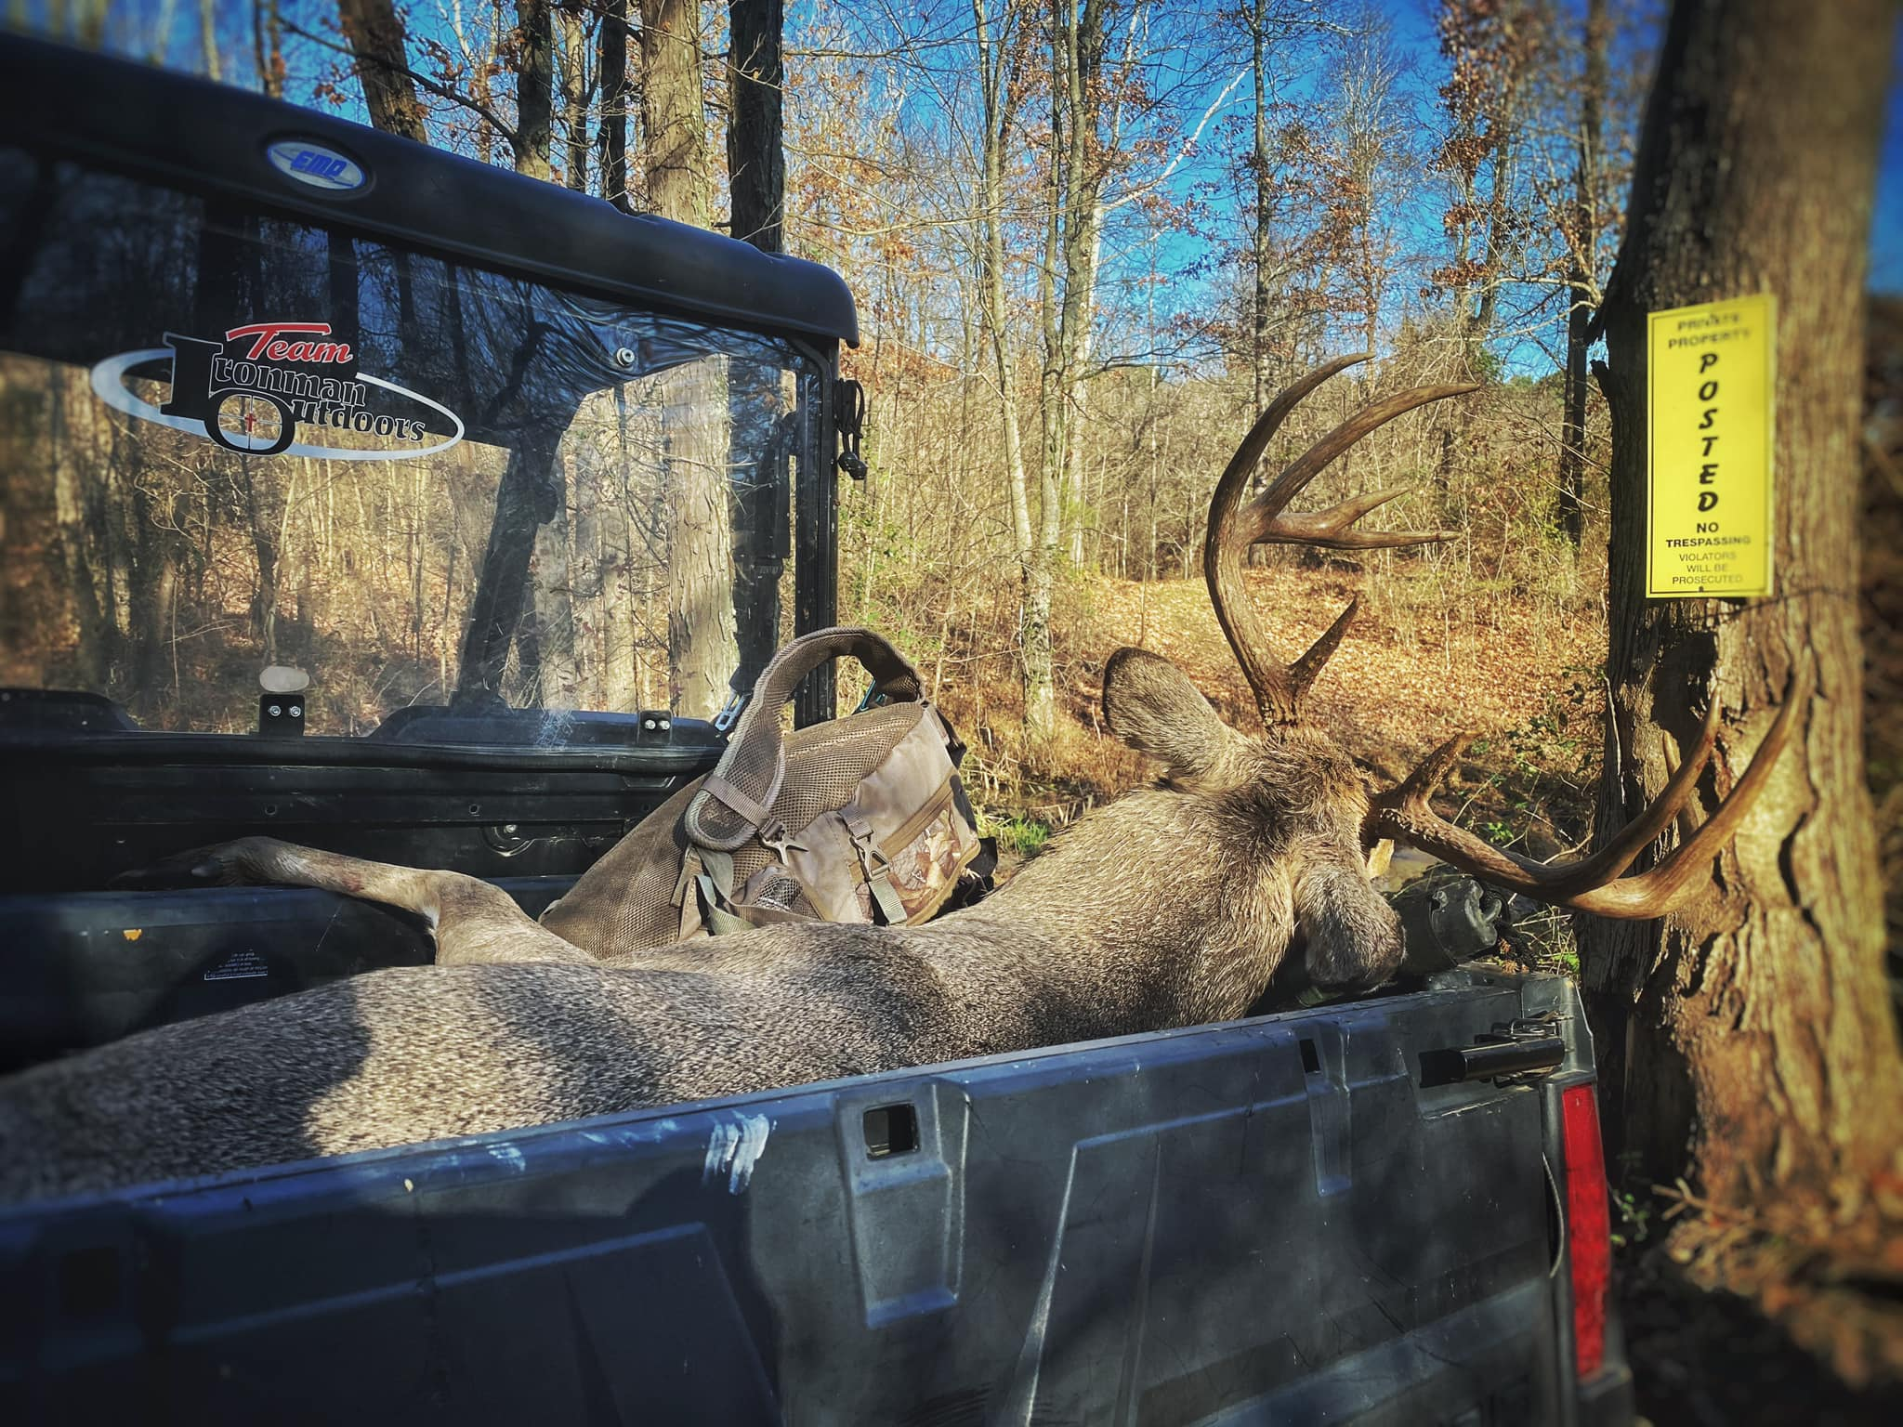
For this retreat, we will be hunting on land where Ironman Outdoors has the exclusive hunting rights.
IronmanOutdoors.org

Slide 5
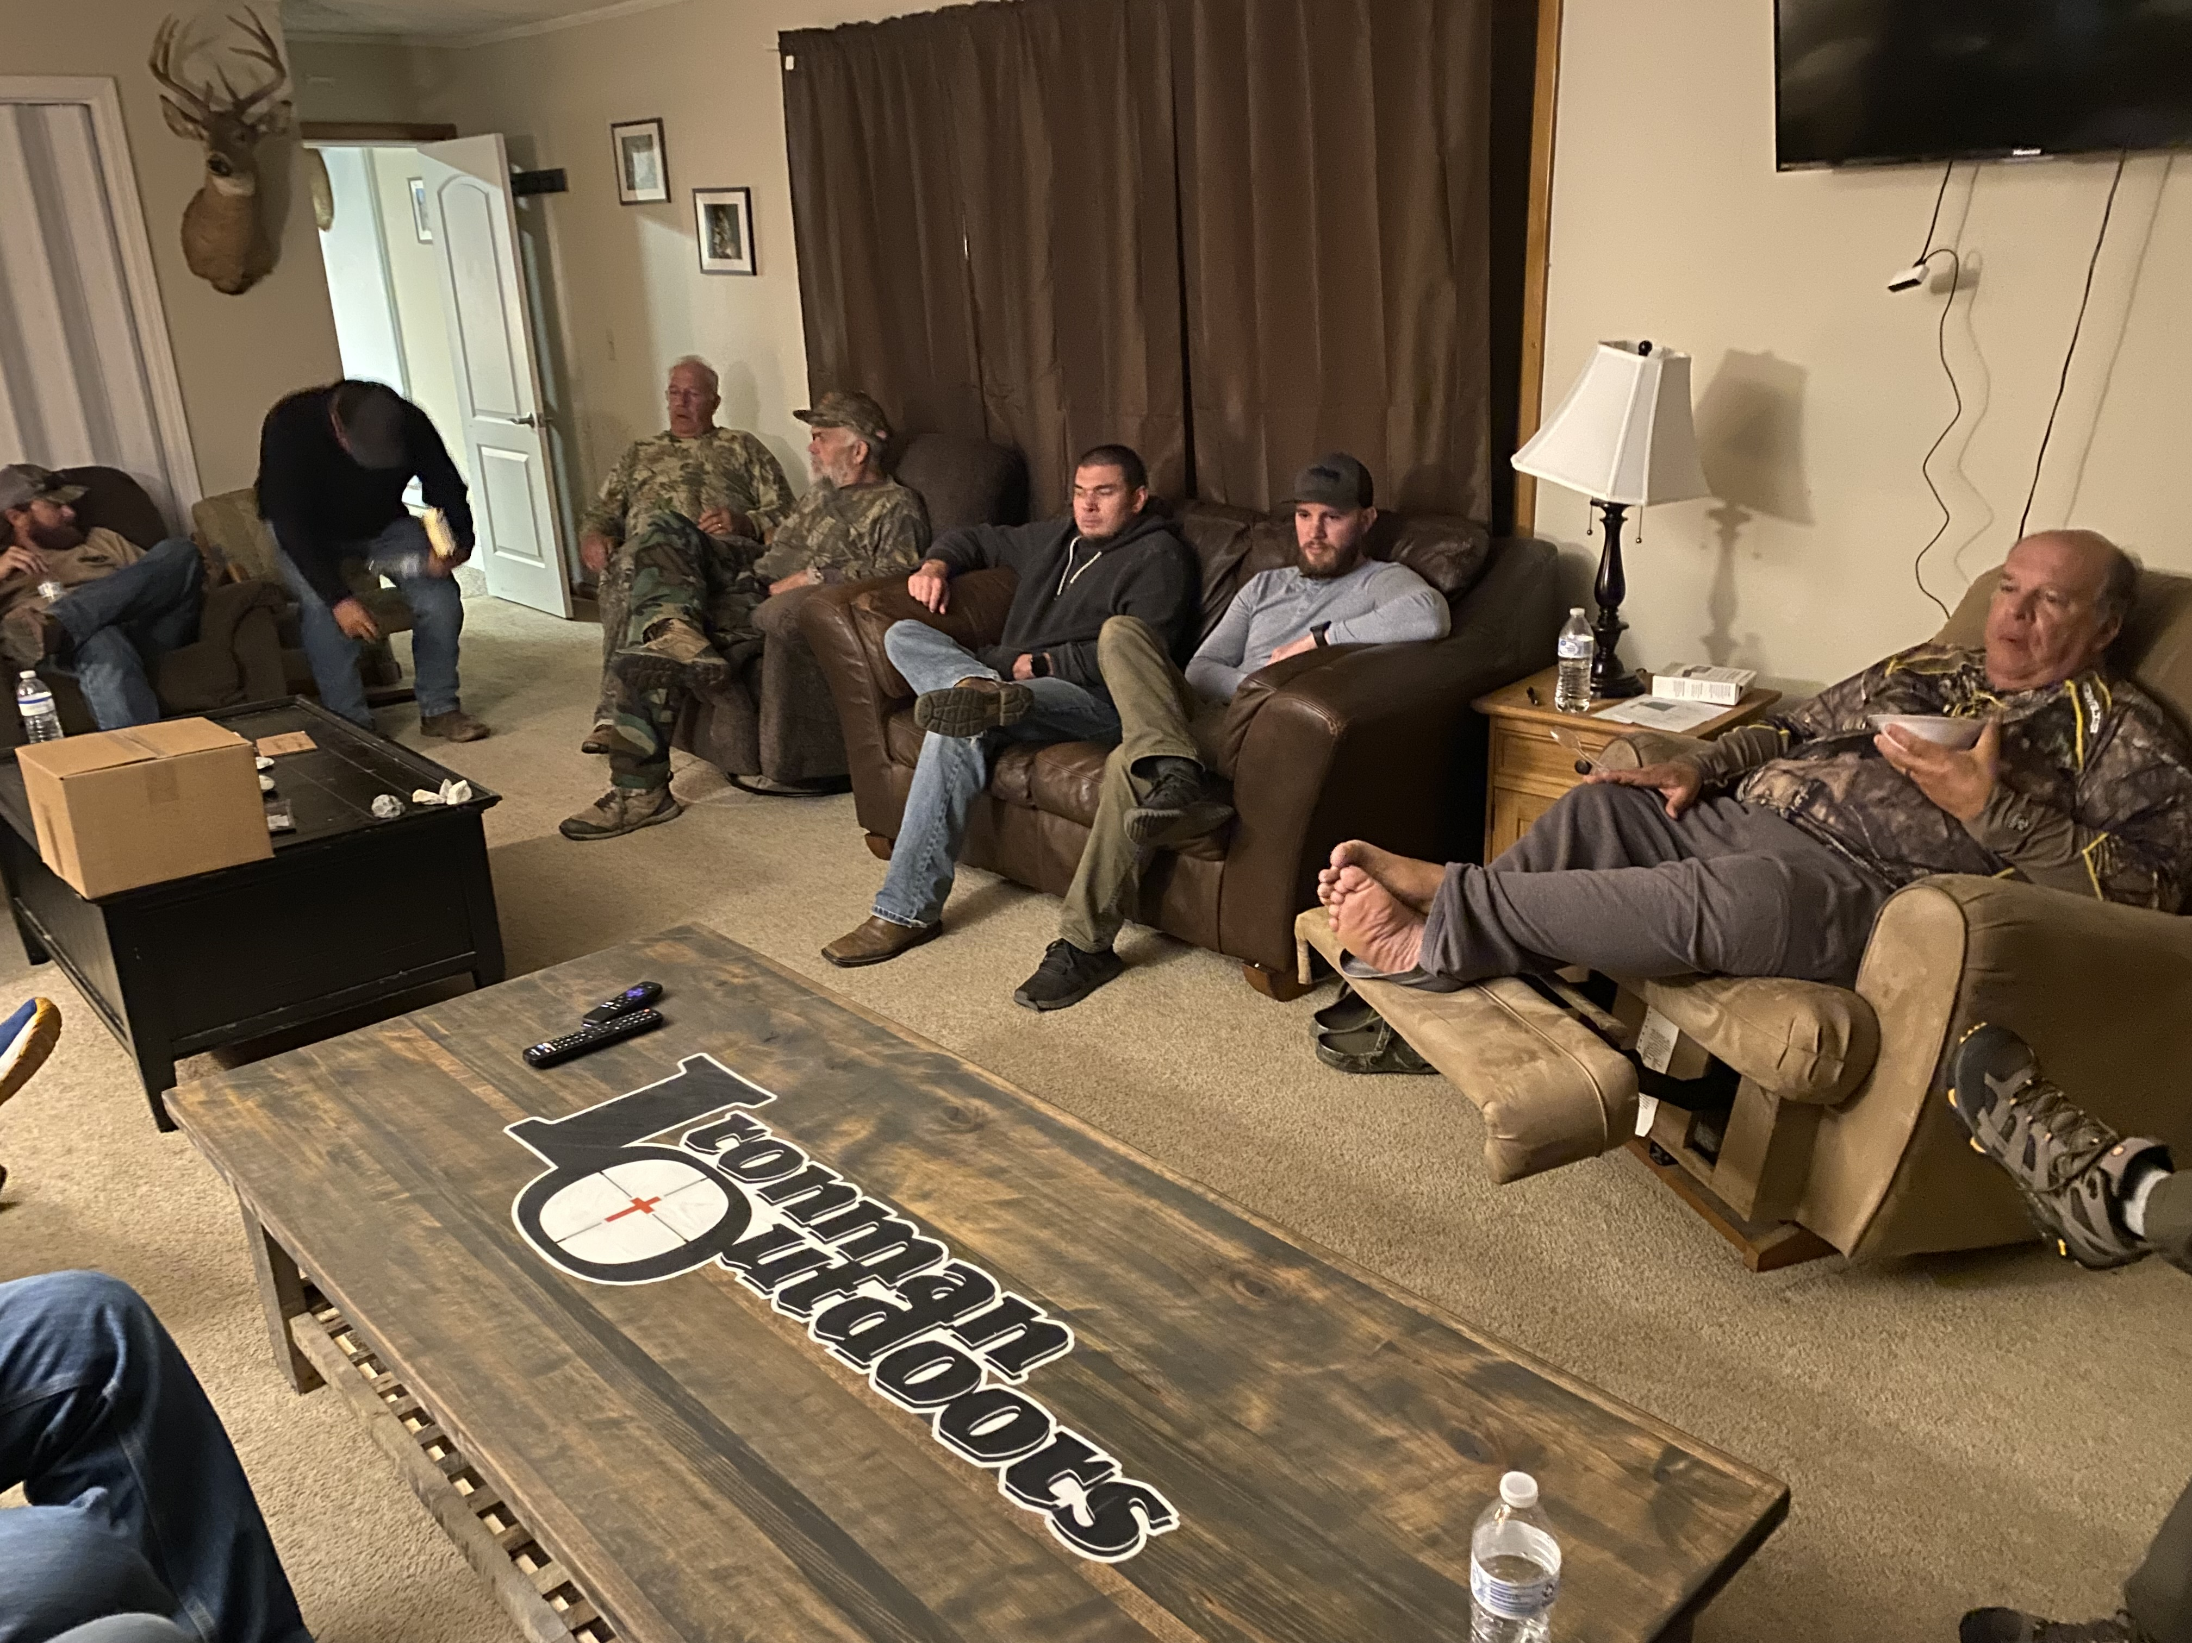
For lodging, we will be staying in a bunkhouse not too far from the hunting properties.
Guests will need a pillow and a sleeping bag or a heavy blanket as part of their packing list.
Linens are NOT provided.
IronmanOutdoors.org

Slide 6
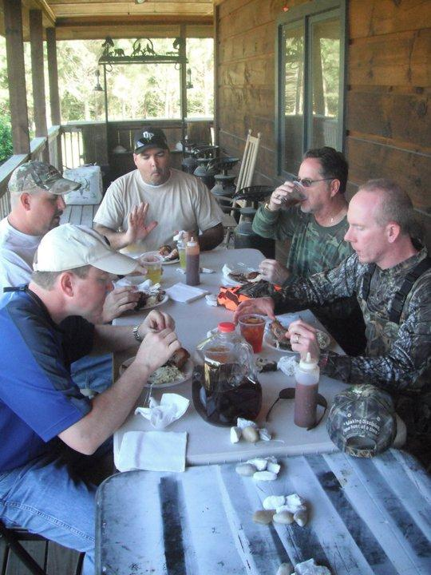
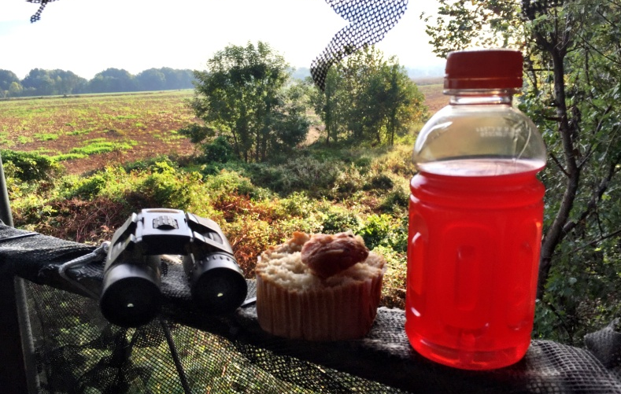
Meals and snacks will be provided…. including snacks that you can take with you to the treestand.
Please DO NOT leave trash on (or in) the stands.
IronmanOutdoors.org
Notes:
6

Slide 7
HUNTING LICENSE
Prior to allowing anyone to hunt, each attendee will be required to:
Sign a liability waiver
Show a Valid Hunting License for the state of KY.
A Kentucky hunting license is available for purchase on-line by clicking the attached DNR logo.
Note - If you violate a game law, you will be asked to leave the retreat without refund.
IronmanOutdoors.org

Slide 8
All Bucks Harvested Must Have at least 4 points on one side and minimum inside spread of at least 15 inches.
The penalty for shooting a buck with less than the required minimum size is $500.
Payment will be collected before you leave the retreat.
Note: once you draw blood on a buck you are done hunting for bucks on that retreat (even if we don’t find it).
IronmanOutdoors.org

Slide 9
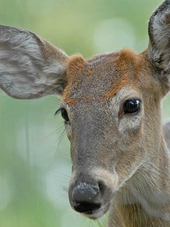
Button Bucks (read carefully)
If you shoot a button buck on this retreat, it will count as your buck harvest for the retreat. Or, if you elect to continue hunting for a trophy buck, a fine of $500 will be collected if you harvest another buck.
Payment will be collected before you leave the retreat.
IronmanOutdoors.org

Slide 10
HARVEST LIMITS
During the retreat, each hunter will be allowed to harvest 1 doe and 1 buck (that meets the size requirements).
Hunters can harvest 1 buck with at least 4 points on one side and 15 inch wide inside spread.
We will have a place where you can skin and clean your harvest but we suggest that you bring a cooler to transport any meat harvested. If you have never cleaned an animal, our volunteers will be happy to help you clean your animal.
IronmanOutdoors.org
Notes:
10

Slide 11
MANHOOD DISCUSSIONS
During our time together, we will gather as a group to conduct our “Manhood Discussions”
These discussions are simply an authentic and transparent conversation about what it means to be a Christian man.
Topics may range from hunting, work, fatherhood and women to leadership, sports and everyday life.
These are Not Bible Studies, They’re Not Devotions and They’re Not Sermons.
Every man on the retreat is respectfully asked to be present for these discussions.
IronmanOutdoors.org
Notes:
11

Slide 12
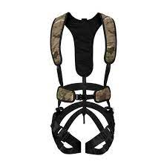
Safety: if hunting from a treestand during the retreat, you must bring your own safety harness and wear it. Safety lifelines will be attached to every stand.

Slide 13
PACKING LISTS
MANDATORY
SUGGESTED
Valid KY Hunting License
Rifle, orange hat, orange vest
Flashlight
Towel & Scent-Free Soap
Sleeping bag, Pillow and blanket
No Personal Treestands Allowed
No alcohol allowed
Tree stand safety harness
Rain Gear & Rubber Boots
Cooler
Bug Spray and/or Thermacell
Rangefinder & Binoculars
Cooler to take home “harvest”
“Camp Chair”
Cushion to sit on – while Hunting
IronmanOutdoors.org
Notes:
13

Slide 14
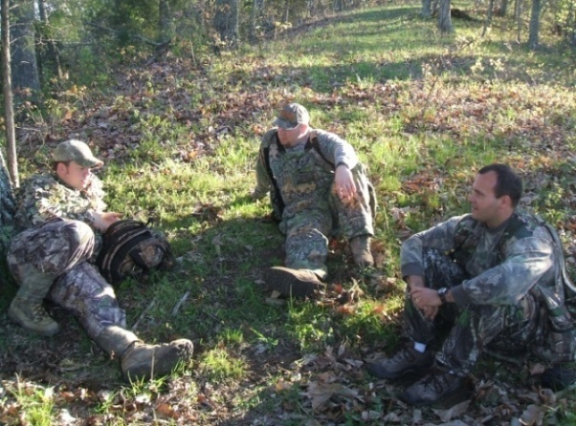
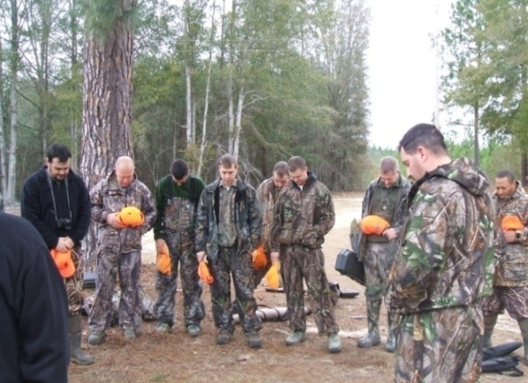
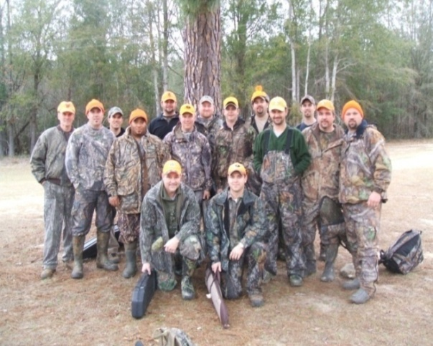
Event Schedule
* Please allow some flexibility with this schedule
Friday, Nov. 8
5:00pm - Arrive at Camp –
6:30pm - Introductions & Mandatory Safety Discussion
7:00pm -Dinner
7:30pm - Manhood Discussion
Saturday, Sunday, Monday, Nov. 9, 10, 11
5:30am - Light Breakfast
6:00am - Head to Woods
12:00pm - Lunch, Nap, Socialize
3:00pm - Head to the woods
8:00pm - Dinner
8:30pm - Manhood Discussion
Tuesday, Nov. 12
7:00am - Clean up & Depart Camp (no hunting)
Notes:
14

Slide 15
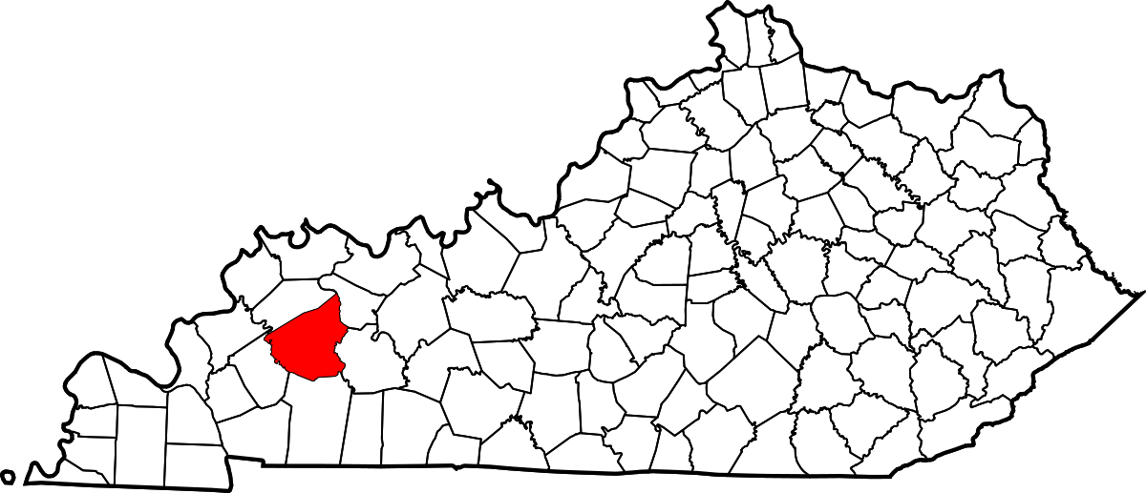
Driving Directions
An exact address will be provided as we draw closer to the retreat, but for planning purposes, you will need to be near Madisonville, KY around 5:00pm on Friday, Nov. 8.
IronmanOutdoors.org

Slide 16
Our Policy:
REFUNDS
We can allow refunds if given 30 days notice before the retreat. We will subtract 3% if fees were paid with a card.
No refunds within 30 days of the retreat.
A deposit (usually 50% of hunt cost) is required upon booking a retreat. No retreat will be considered booked until Ironman Outdoors receives a deposit.
IronmanOutdoors.org
Notes:
16

Slide 17
Our Policy:
BALANCE DUE
Any outstanding or remaining reservation balance is due at least 14 days prior to the retreat.
All retreats must be paid in full before any hunting takes place.
To make final payment, go to the donation page on our website. Put retreat name and date in the comment box.
IronmanOutdoors.org
Notes:
17

Slide 18
As Iron Sharpens Iron, so One Man Sharpens Another.
Proverbs 27:17
IronmanOutdoors.org
Notes:
18

Slide 19
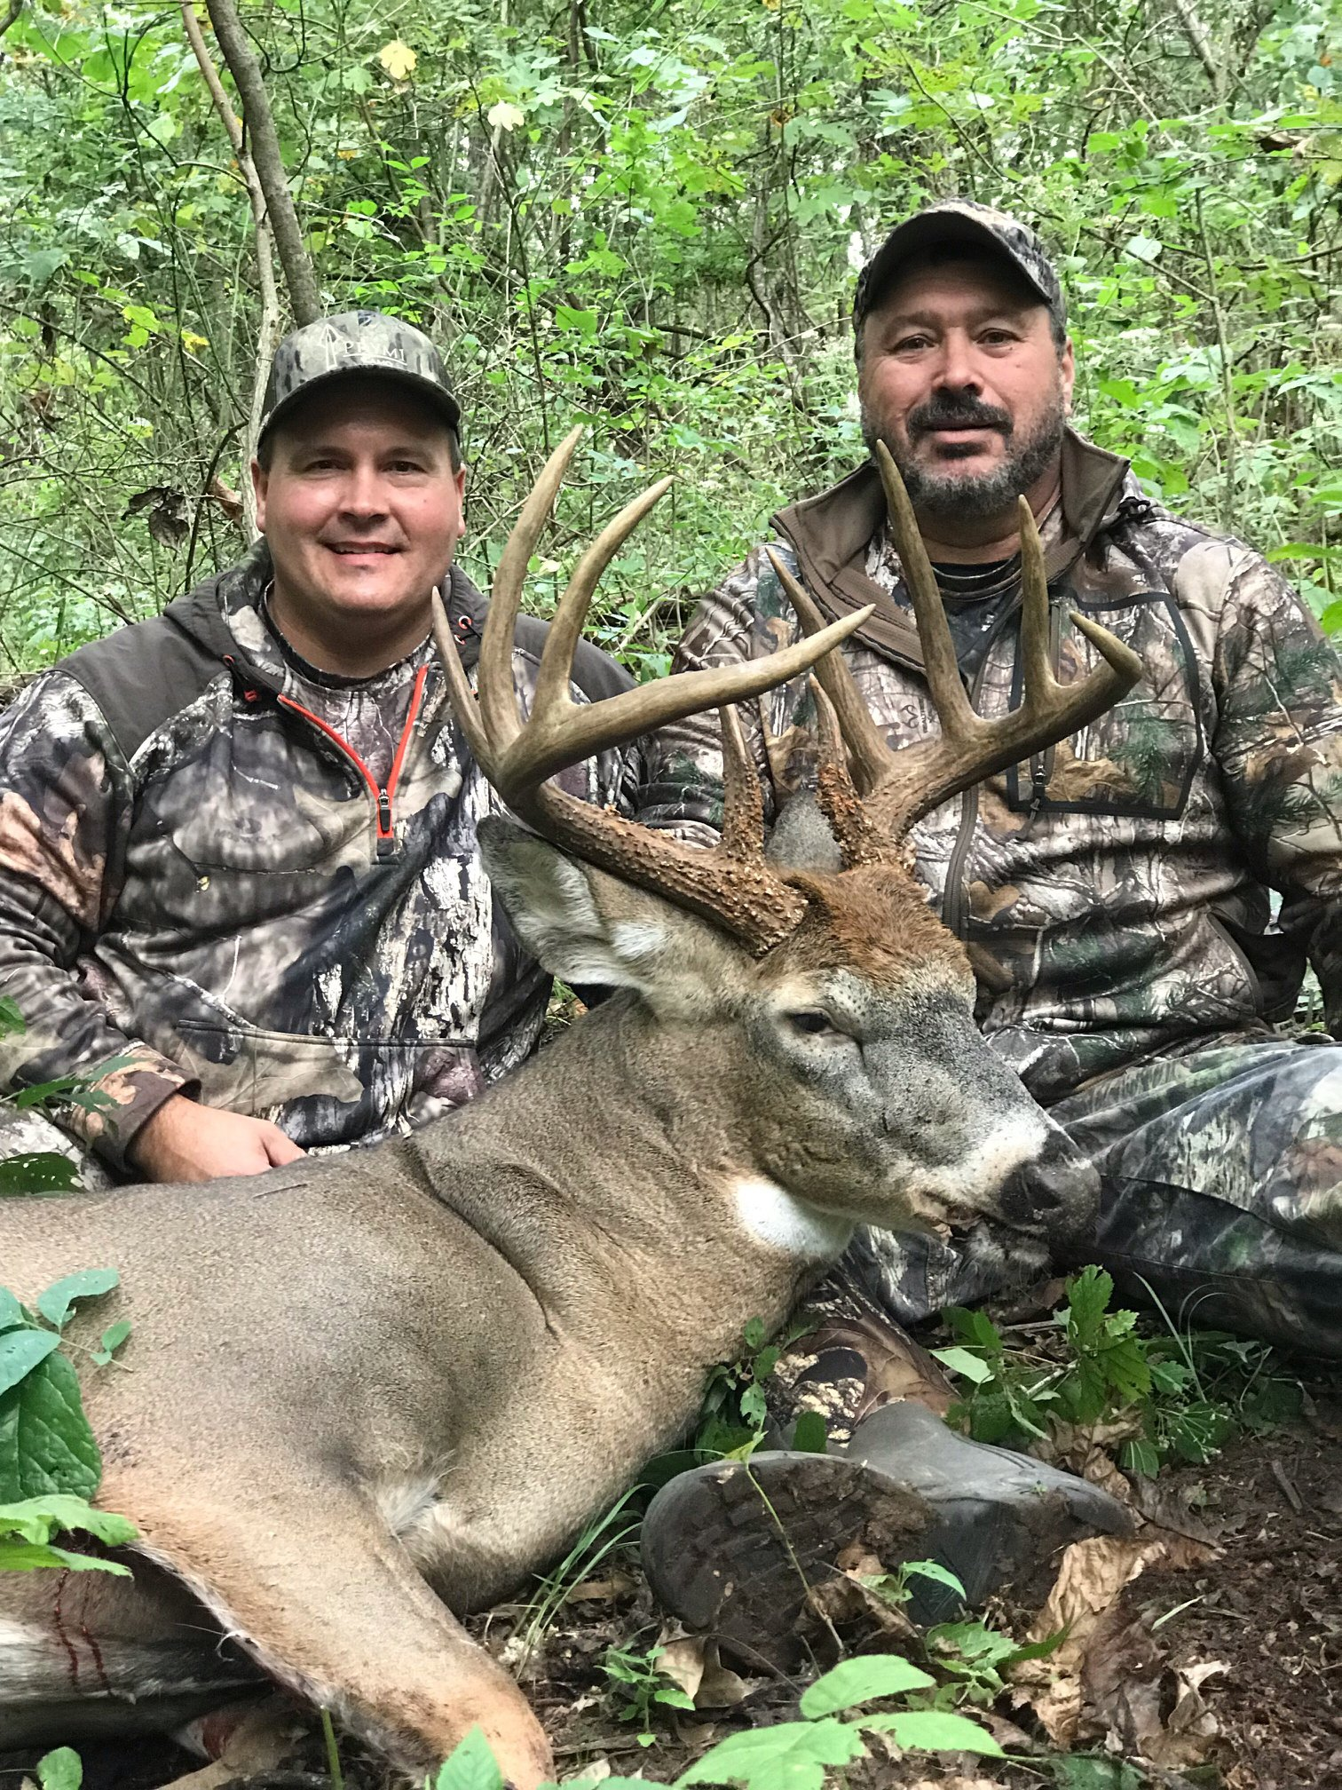
Patrick Tyndall
Ironman Outdoors
803-465-1981
Patrick@ironmanoutdoors.org
IronmanOutdoors.org
Notes:
19

